Slide 1
Usage of SDR to Decode Tire Pressure Monitoring System (TPMS)
Kevin Hardin
Koffi Onipoh
April 17, 2023
https://youtu.be/B5I9xX3ARJk

Slide 2
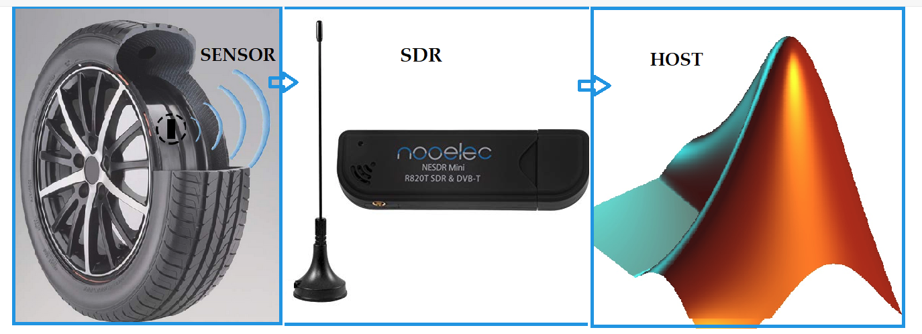
Introduction
Using a software defined radio (SDR) module (Nooelec NESDR Mini SDR & DVB-T USB Stick) and MATLAB, this project aims to:
Implement a generic tire pressure monitoring system (TPMS) receiver as a proof of concept
Investigate frequency modulation schemes and data coding used in vehicle tire pressure monitoring systems (TPMSs)
Perform TPMS data capture
Evaluate security risks associated with TPMS usage
Questions remain whether TPMS data can be cheaply obtained and captured while the vehicle is in motion, the answers to which are required to fully substantiate TPMS security threat concerns.

Slide 3
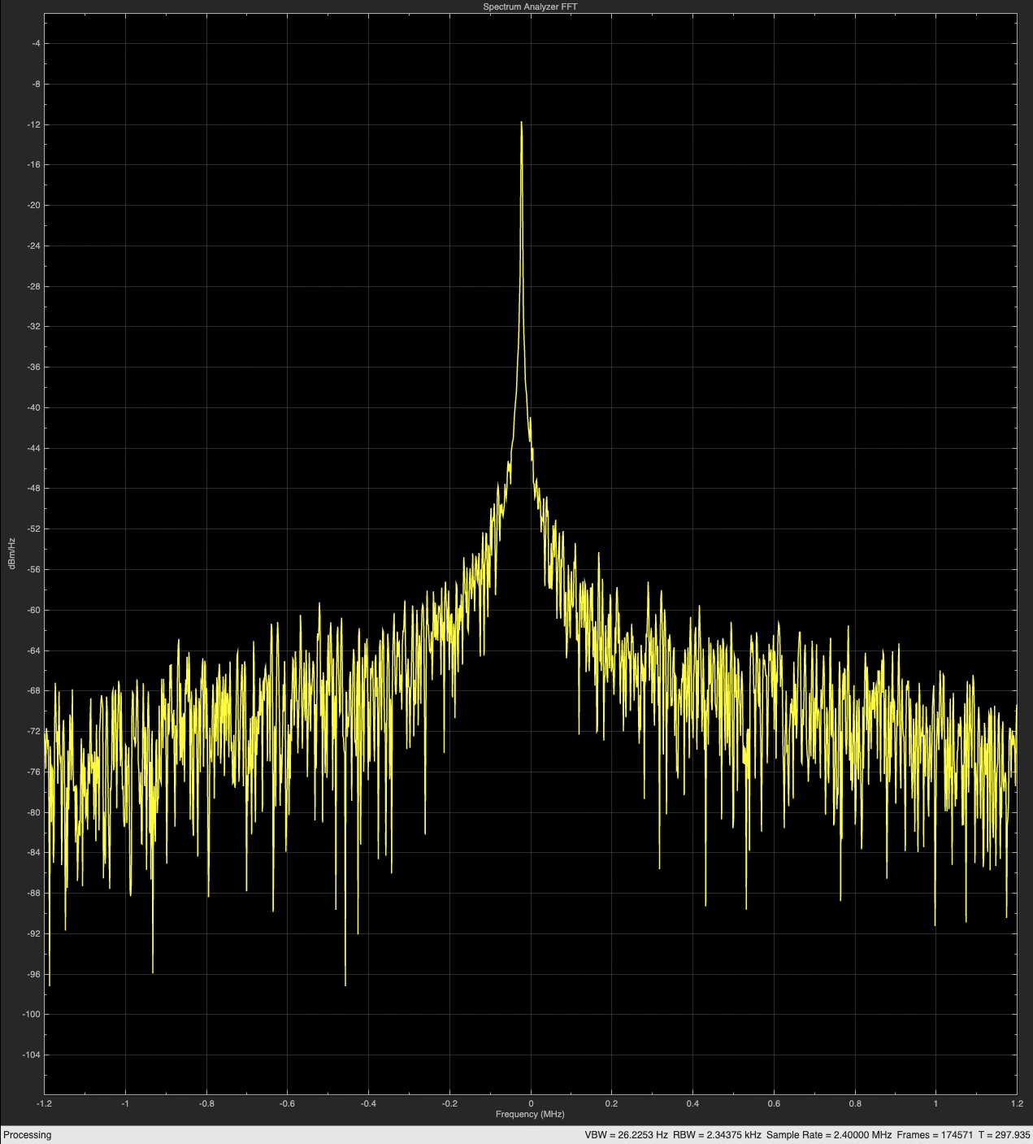
Literature Review
A TPMS consists of:
Tiny battery-powered wireless sensors mounted in the wheels of the vehicle
A base station embedded in the vehicle control system
Tire pressure information collected by the sensors wirelessly transmitted to the base station, typically on license free bands such as 315 MHz or 433 MHz [1]
Security concerns:
Hackers snooping communications can spoof tire pressure readings [2]
TPMSs lack rigorous security and represent one of the entry points for automotive cyberattacks [5]

Slide 4
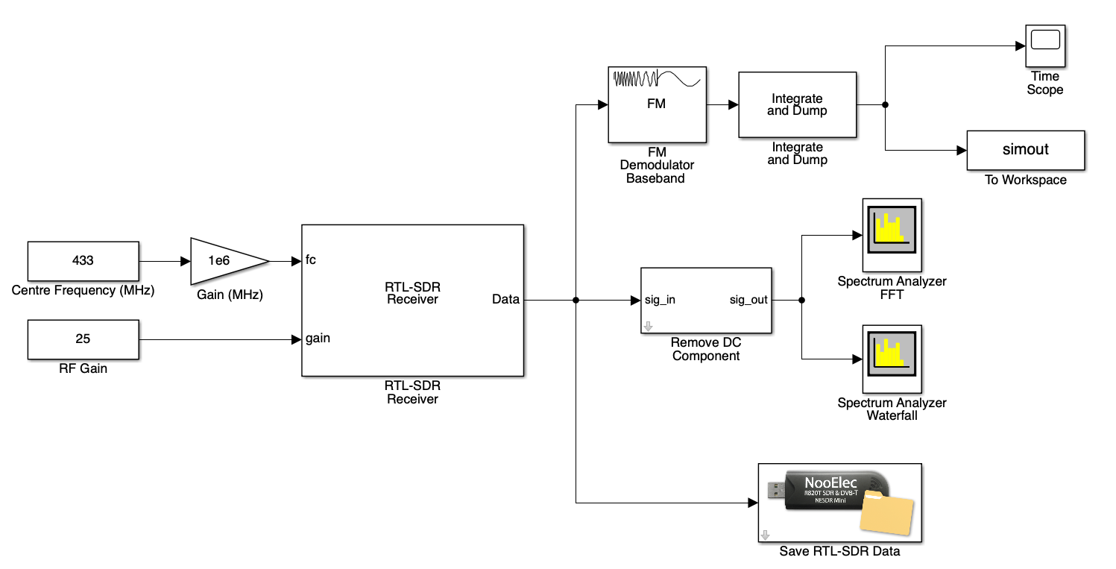
Methodology
The system architecture was designed using Noolec NESDR as an RF receiver and a software-based demodulator, filter, and decoder.
The TPMS sensors were sampled at 125 kHz using a vehicle’s fault diagnostic and scan tool
The baseband signal was recorded, stored, then processed using Simulink blocks and MATLAB scripts
Distance testing was performed to assess security threats. This testing helps evaluate and propose future sensing applications that inform the requisite relative position of vehicles and the SDR receiver for successful acquisition of the signal.

Slide 5
RESULTS ANALYSIS
The decoded data exhibits a 150-bit long frame
The output waveform is a string of one or two bits of the same nature, which characterizes Manchester encoding.
After running several tests and comparing the results, the first 8-10 bits were identified as preamble, with the remaining 140 bits being the TPMS packet information.
Each time the activation signal was sent and the tire pressure and surrounding temperature were intentionally modified using Thindiag2, some bitfields displayed regular repetitions of patterns. The static fields were 32-bits long and were identified as the sensor ID information fields.
The fields attributed to the temperature and pressure are 8-bits long each.
The other bits were attributed to the Sync, CRC, and Flag data.
Bits size | 10 | 8 | 8 | 8 | 32 | 8 | 8
Field | Preamble | Sync | Pressure | Temperature | ID | Flags | CRC

Slide 6
Discussion
More data is required to ascertain if the data of some models of TPMS sensors are encrypted and therefore more secure.
It was discovered during this project TPMS sensors communication protocols vary from one manufacturer to the other. FSK, ASK, OOK modulation and encoding scheme (Manchester code, Differential Manchester code, NRZ, etc.) are used, which can impact data capture. Hence snooping TPMS data is possible but challenging.
Roadside and distance testing was performed by driving a few miles in the main street where other motorists were. Only 2% of the transmissions captured were from other cars; the remaining 98% was from the car carrying the receiver. This confirms, that snooping in TPMS packets on moving cars is a rather difficult undertaking.
Capturing TPMS data from other cars while moving is difficult, which makes any security vulnerabilities associated with TPMS unlikely to pose a real threat.

Slide 7
Conclusion
The main objective of this project was to demonstrate the ability of a low-cost RTL SDR device to pick up TPMS packets and evaluate the associated security ramifications. This goal was successfully attained by building a MATLAB-based receiver and capturing data on a personal car.
Although, the possibility of snooping data from distant and moving cars remains low, it’s not impossible.
Therefore, the team plans to continue working, beyond the scope of this class, to determine and implement an application to estimate a distance limit between the receiver and transmitter, beyond which TPMS data cannot be captured.
The information gleaned from this project is shared online and will enable others to build low cost TPMS receivers. (see “Additional Materials”)

Slide 8
Acknowledgments
Thank you very much to:
Dr. Kihei and Dr. Dr. Sumit Chakravarty
Friends and family

Slide 9
References
N. N. Hasan, A. Arif, M. Hassam, S. S. Ul Husnain and U. Pervez, "Implementation of Tire Pressure Monitoring System with wireless communication," 2011 International Conference on Communications, Computing and Control Applications (CCCA), Hammamet, Tunisia, 2011, pp. 1-4, doi: 10.1109/CCCA.2011.6031524.
Z. El-Rewini, K. Sadatsharan, N. Sugunaraj, D. F. Selvaraj, S. J. Plathottam and P. Ranganathan, "Cybersecurity Attacks in Vehicular Sensors," in IEEE Sensors Journal, vol. 20, no. 22, pp. 13752-13767, 15 Nov.15, 2020, doi: 10.1109/JSEN.2020.3004275.
D. K. Kilcoyne, S. Bendelac, J. M. Ernst and A. J. Michaels, "Tire Pressure Monitoring System encryption to improve vehicular security," MILCOM 2016 - 2016 IEEE Military Communications Conference, Baltimore, MD, USA, 2016, pp. 1219-1224, doi: 10.1109/MILCOM.2016.7795497.
S. Malipatlolla, T. Feller and S. A. Huss, "An adaptive system architecture for mitigating asymmetric cryptography weaknesses on TPMs," 2012 NASA/ESA Conference on Adaptive Hardware and Systems (AHS), Erlangen, Germany, 2012, pp. 221-226, doi:10.1109/AHS.2012.6268654.
Stephen Checkoway, Damon McCoy, Brian Kantor, Danny Anderson, Hovav Shacham, Stefan Savage, Karl Koscher, Alexei Czeskis, Franziska Roesner, and Tadayoshi Kohno. 2011. Comprehensive experimental analyses of automotive attack surfaces. In Proceedings of the 20th USENIX conference on Security (SEC'11). USENIX Association, USA, 6.
J. Han, X. Tang, C. Meng and Y. Liu, "Research on ABS and TPMS System Merging Technology," 2009 International Conference on Intelligent Human-Machine Systems and Cybernetics, Hangzhou, China, 2009, pp. 141-144, doi: 10.1109/IHMSC.2009.43.
S. Y. Kim, C. S. Chae, I. Hwang, S. Lim, H. W. Choi and D. J. Kim, "Design of low power operational TPMS system," 2015 IEEE Pacific Rim Conference on Communications, Computers and Signal Processing (PACRIM), Victoria, BC, Canada, 2015, pp. 344-347, doi: 10.1109/PACRIM.2015.7334859.
Basagni, S., Carosi, A. and Petrioli, C. (2008). Mobility in Wireless Sensor Networks. In Algorithms and Protocols for Wireless Sensor Networks (eds A.Y. Zomaya and A. Boukerche). https://doi.org/10.1002/9780470396360.ch10

Slide 10
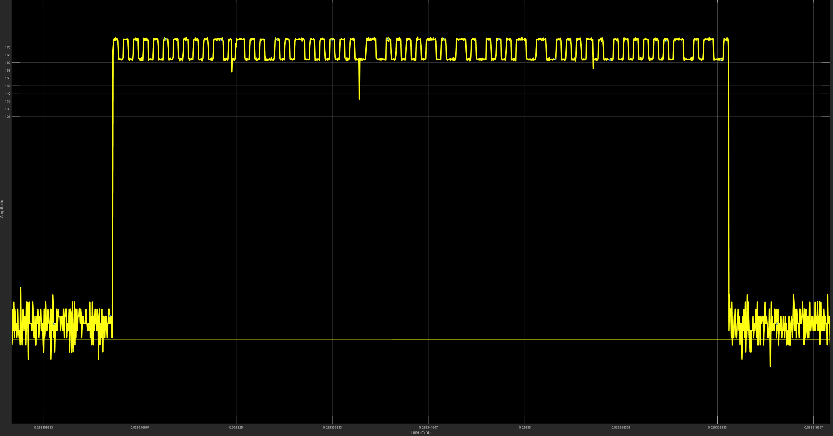
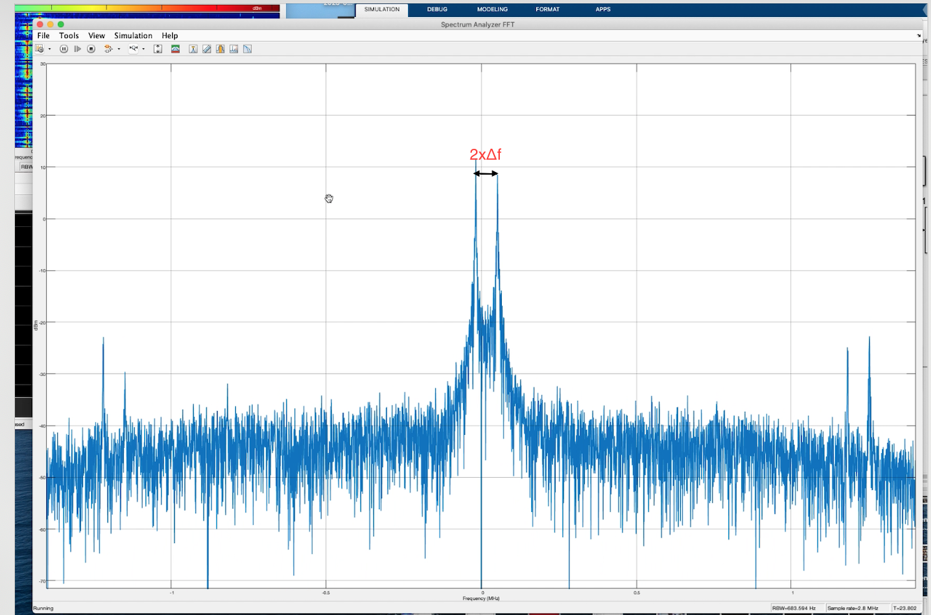
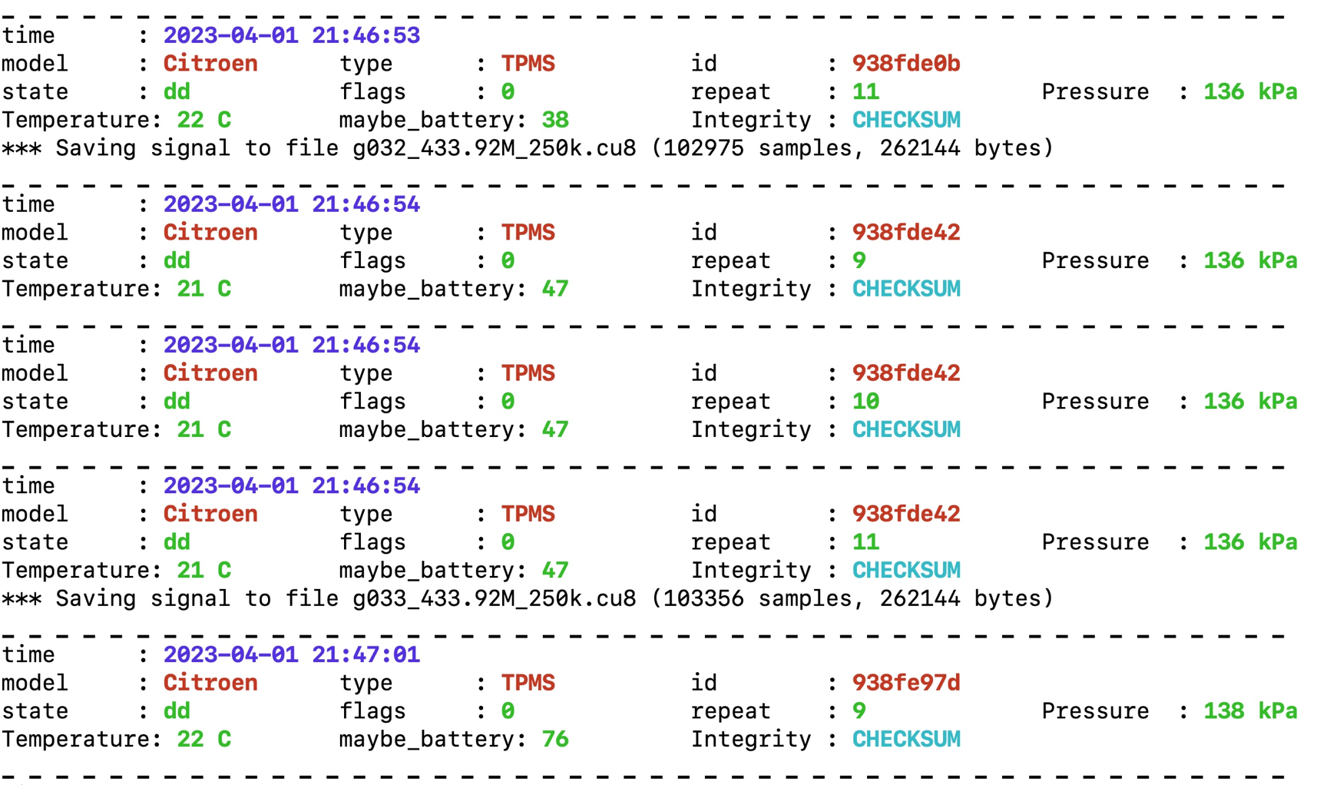
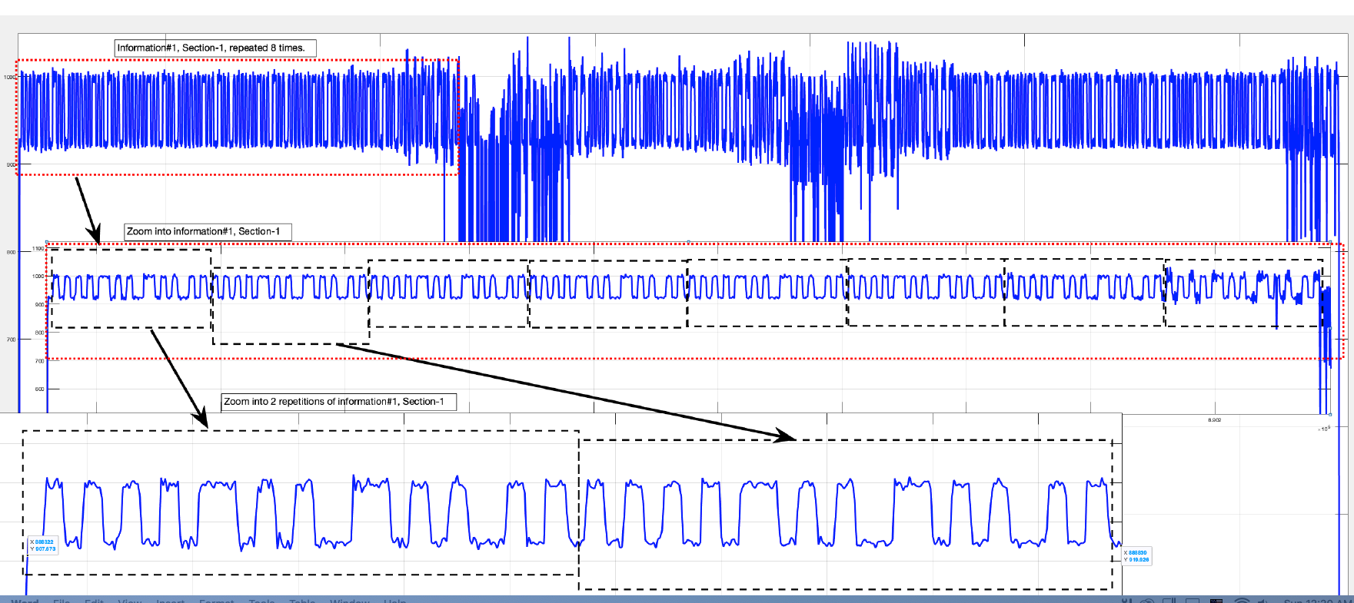
Additional Materials
Spectrum Analyzer FFT of the Raw received signal
Roadside captured data
Demodulated TPMS data displaying bit train
Github code repository: https://github.com/khardi20/TPMS-Code

